Slide 2
There are many methods can be used for knowledge representation
Semantic networks.
Conceptual graph.

Slide 3
Semantic Networks
It is consist of a set of nodes and arcs, each node is represented as a rectangle to describe the objects, the concepts and events. The arcs are used to connect the nodes and they divided to three parts which are (IS), (IS A), (Can), and(Has a)

Slide 4
Example1: Computer has much part like a CPU and computer divided into two types, the first one is the mainframe and the second is the personal computer, Mainframe has line printer with large sheet but the personal computer has laser printer, IBM as example to the mainframe and pIII and pIV as example the personal computer.

Slide 5
computer
Has a
CPU

Slide 6
computer
Has a
CPU
is a
is a
PC
Mainframe

Slide 7
computer
Has a
CPU
is a
is a
Has a
Line
printer
PC
Mainframe

Slide 8
computer
Has a
CPU
is a
is a
Laser
printer
Has a
Has a
Line
printer
PC
Mainframe

Slide 9
computer
Has a
CPU
is a
is a
Laser
printer
Has a
Has a
Line
printer
PC
Mainframe
is a
is a
is a
PIV
PII
IMP

Slide 10
Example2: create the semantic network for the following facts (Note: You must append new indirect facts if they exist):
A trout is a fish
A fish has gills
A fish has fins
Fish is food
Fish is animal

Slide 11
trout
has
is a
gills
has
has
Fish
fins
is
is
food
Animal

Slide 12
Example3: Frosty is a snowman.
A snowman is made of snow.
Snow is frozen water.
It is slippery and soft.
Snow is cold.
Ice is also cold.
It is also frozen water, but unlike snow, which is soft, ice is hard. Ice is clear in color.

Slide 13
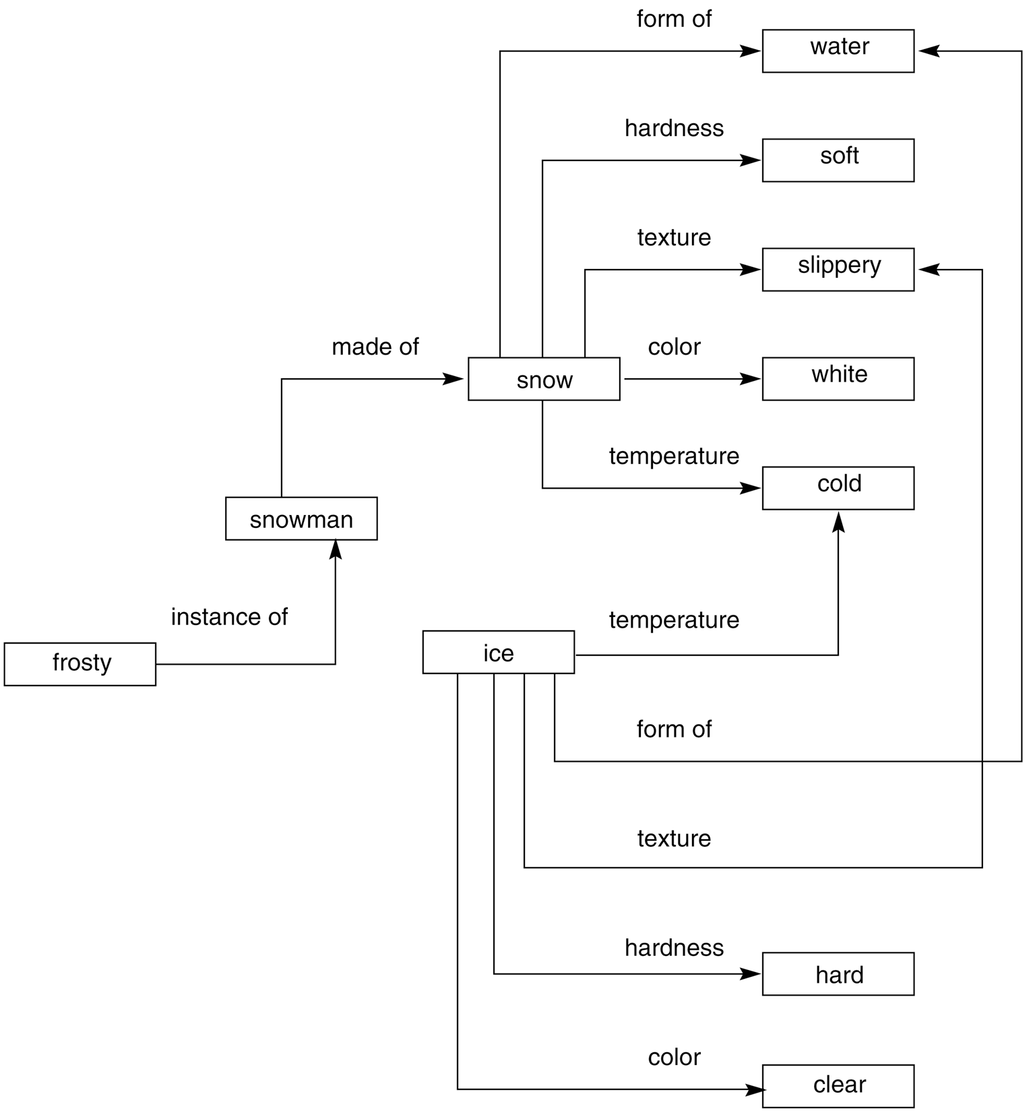
Figure 6.2: Network representation of properties of snow and ice.

Slide 14
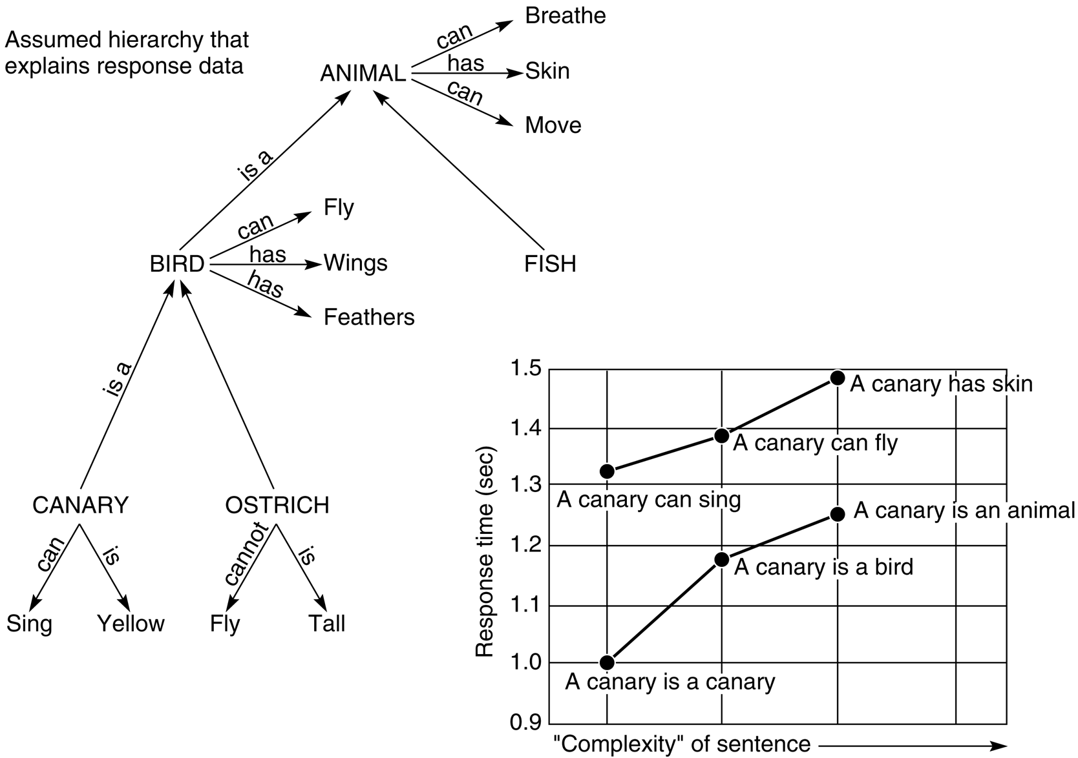
Figure 6.1: Semantic network developed by Collins and Quillian in their research on human information storage and response times (Harmon and King 1985).

Slide 15
Conceptual Graphs
Conceptual Graphs is a logical formalism that includes classes, relations, individuals and quantifiers. This formalism is based on semantic networks, but it has direct translation to the language of first order predicate logic, from which it takes its semantics. The main feature is standardized graphical representation that like in the case of semantic networks allows human to get quick overview of what the graph means. Conceptual graph is a bipartite orientated graph where instances of concepts are displayed as rectangle and conceptual relations are displayed as ellipse. Oriented edges then link these vertices and denote the existence and orientation of relation

Slide 16
Conceptual Graphs
Graph Structure
Finite, connected, bipartite
Arcs are not labeled
In drawings, concepts are shown in boxes and conceptual relations in ellipses

Slide 17
Graph Structure
1- concept and relation
bird
flies

Slide 18
Graph Structure
1- concept and relation
bird
flies
2- tow concept and relation
dog
color
brown

Slide 19
Graph Structure
1- concept and relation
bird
flies
2- tow concept and relation
dog
color
brown
3- 3 concept and relation
father
child
parents
mother

Slide 20
Example1: Ahmed read a letter yesterday
Ahmed
agent
read
object
letter
time
past

Slide 21
Example2: Mary gives book to John
mary
agent
give
object
book
recipient
john

Slide 22
Example2: John eat soup by his hand

Slide 23
Example2: John eat soup by his hand
john
agent
eat
object
soup
instrument
part
Hand

Slide 24
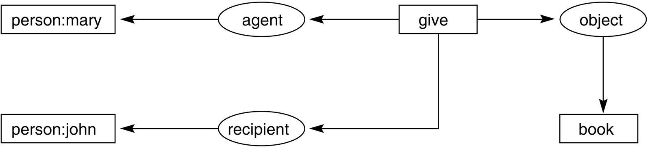
Figure 6.15: Graph of “Mary gave John the book.”

Slide 25
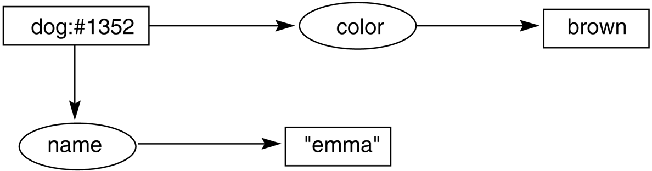
Figure 6.16: Conceptual graph indicating that the dog named emma is brown.
Figure 6.17: Conceptual graph indicating that a particular (but unnamed) dog is brown.
Figure 6.18: Conceptual graph indicating that a dog named emma is brown.

Slide 26
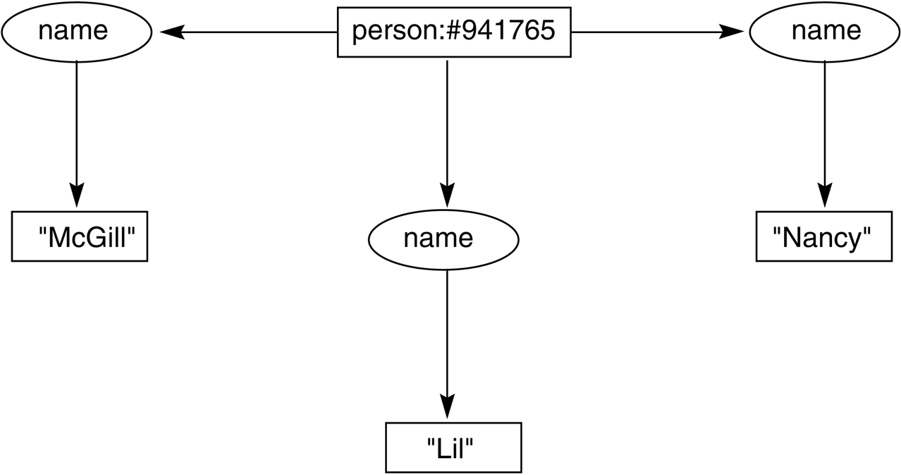
Figure 6.19: Conceptual graph of a person with three names.
Her name was McGill and she called herself Lil but everyone know her as Nancy

Slide 27
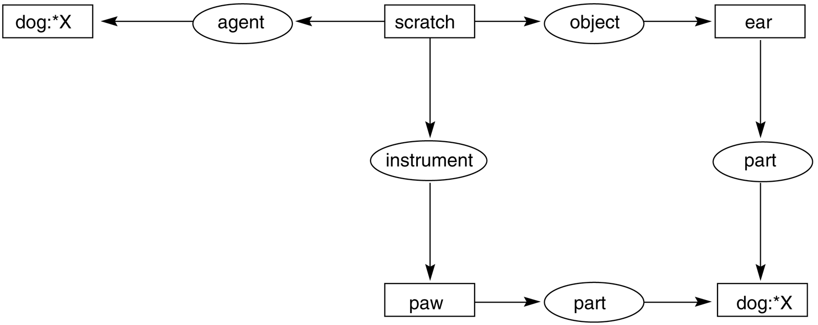
Figure 6.20: Conceptual graph of the sentence “The dog scratches its ear with its paw.”

Slide 28
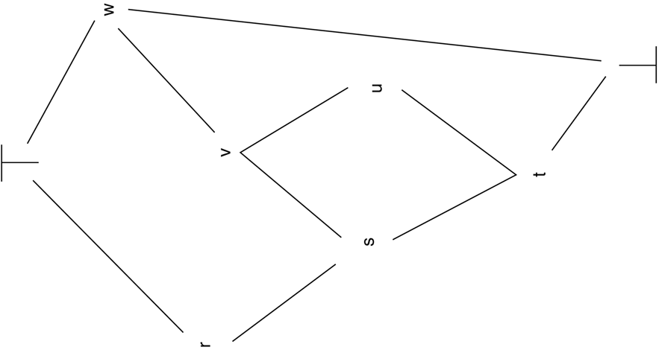
Figure 6.21: A type lattice illustrating subtypes, supertypes, the universal type, and the absurd type. Arcs represent the relationship.

Slide 29
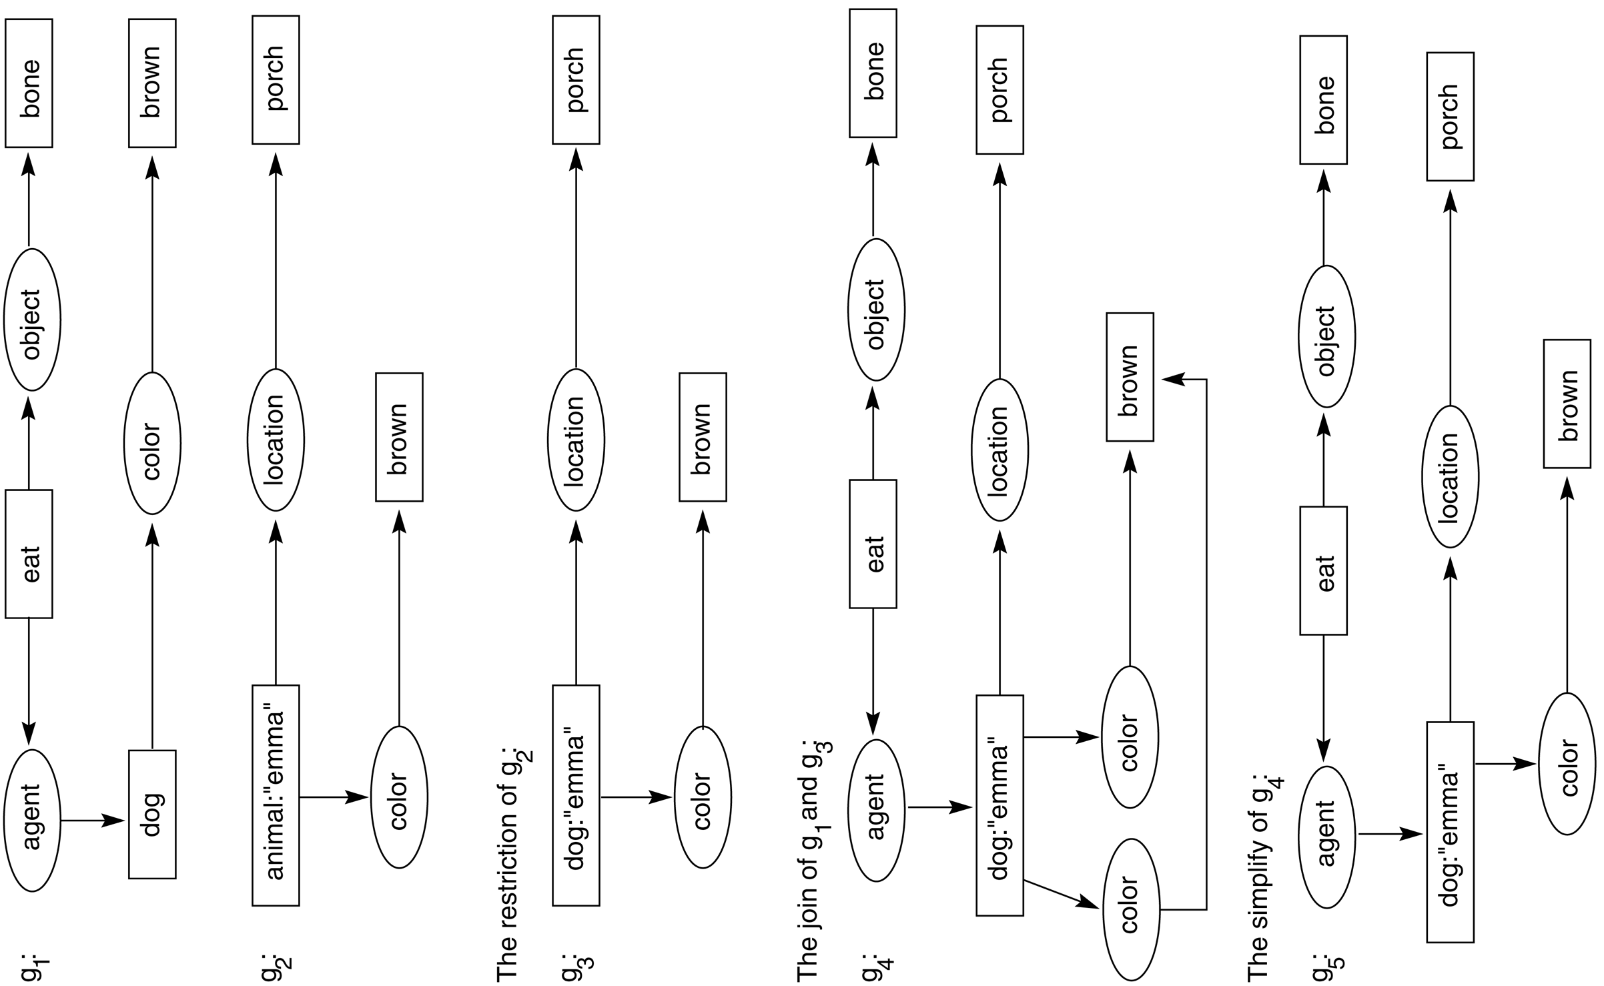
Figure 6.22: Examples of restrict, join, and simplify operations.

Slide 30
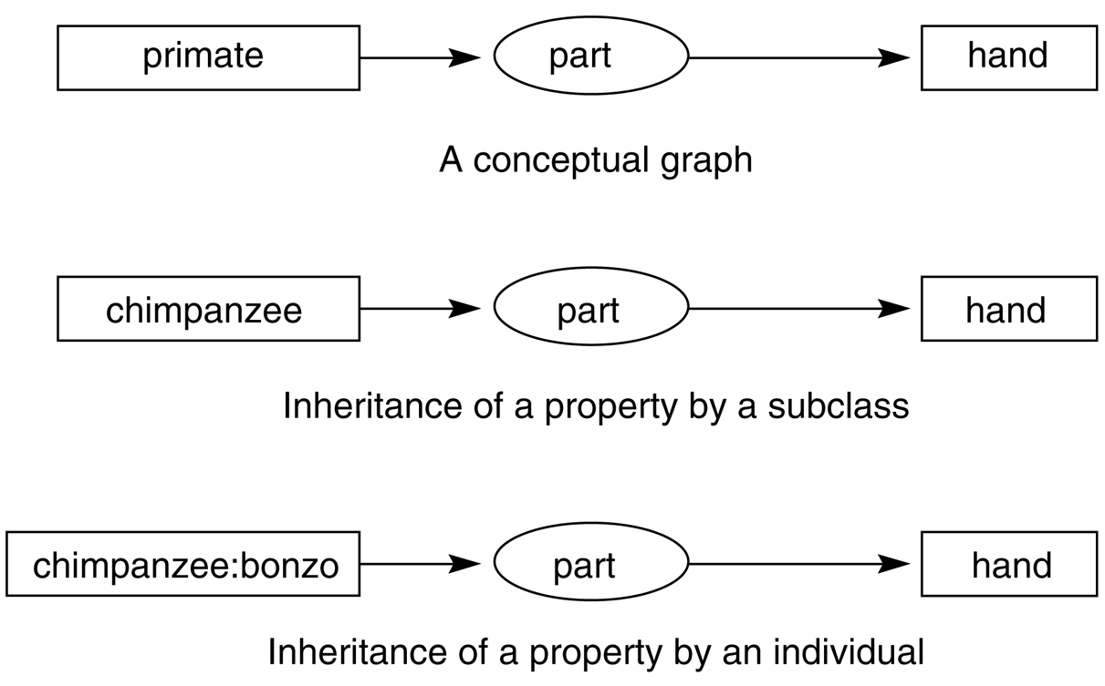
Figure 6.23: Inheritance in conceptual graphs.

Slide 31
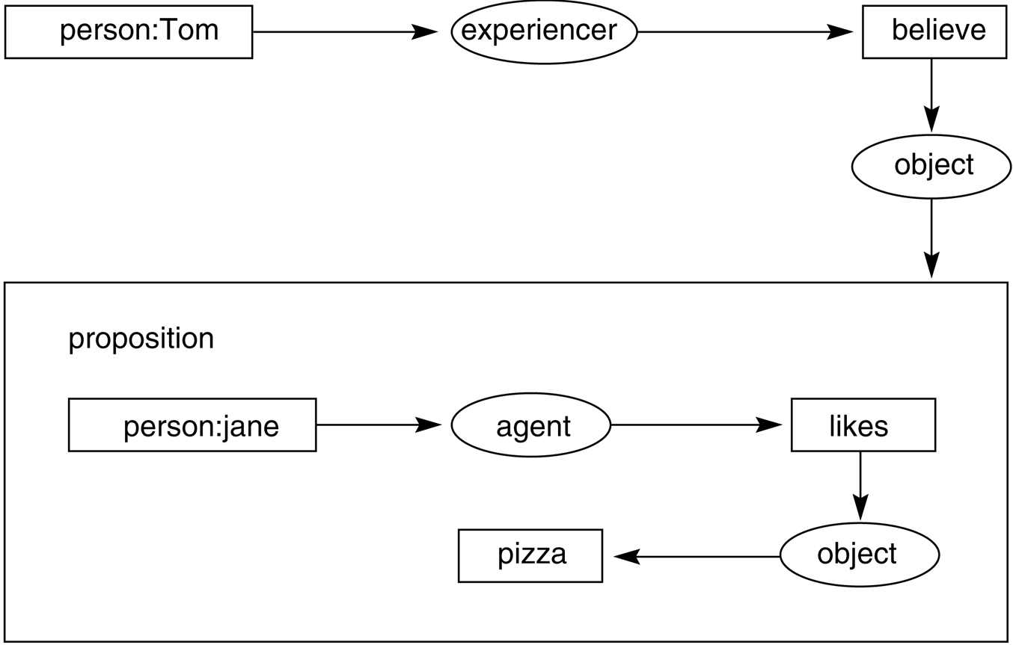
Figure 6.24: Conceptual graph of the statement “Tom believes that Jane likes pizza,” showing the use of a propositional concept.

Slide 32
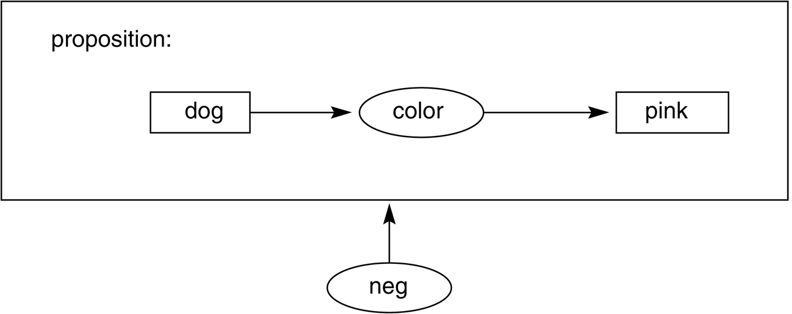
Figure 6.25: Conceptual graph of the proposition “There are no pink dogs.”

